Slide 1
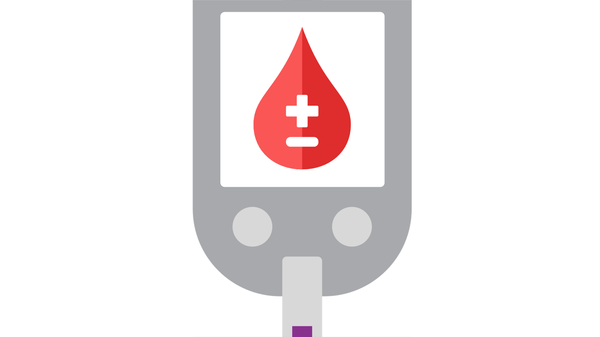


DID YOU KNOW?
There is more than one form of diabetes!
2
TYPE 2
TYPE 1
GESTATIONAL
results from the body’s ineffective use of insulin
results from deficient insulin production and requires daily administration of insulin
occurs during pregnancy
most common
glucose is above normal but still below the diagnostic of diabetes
largely result of excess body weight and physical inactivity
neither its cause nor the means to prevent it are known
women and possibly their children are at increased risk of type 2 diabetes in the future
mostly in adults
more common in children
Information from 2022 World Health Organization Website

